Slide 1
Verilog Implementation of MatRaptor: A Sparse-Sparse Matrix Multiplication Accelerator Based on Row-Wise Product
Based on the paper titled:
“MatRaptor: A Sparse-Sparse Matrix Multiplication Accelerator Based on Row-Wise Product”, by Conrnell University
Presenter: Hazem Taha
Under Supervision of Prof. Mohamed Hassan

Slide 2

Content
Traditional Solutions of Sparse-Sparse Matrix Multiplication
Inner Product Method
Outer Product Method
Challenges
Proposed Solution
Row-wise Product Method
$C^{2}SR$ Sparse Matrix Format
Architecture Design
Test Bench Development
Results

Slide 3
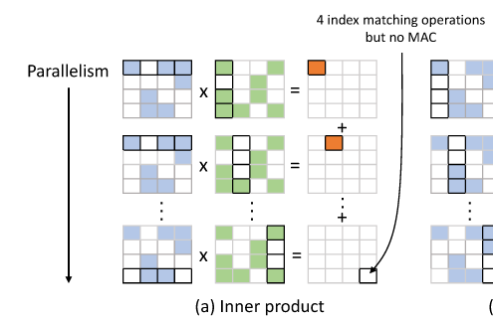

Traditional Solutions
Inner Product Method
Advantages:
Low on-chip memory requirements.
No synchronization required.
Disadvantages:
Inconsistent formatting.
Inefficient index matching.
$$C[i, j]= \sum_{k=1}^{n}{A[i, k]}×B[k, j]$$
N. Srivastava, H. Jin, J. Liu, D. Albonesi, and Z. Zhang, "MatRaptor: A Sparse-Sparse Matrix Multiplication Accelerator Based on Row-Wise Product." Fig. 1.

Slide 4
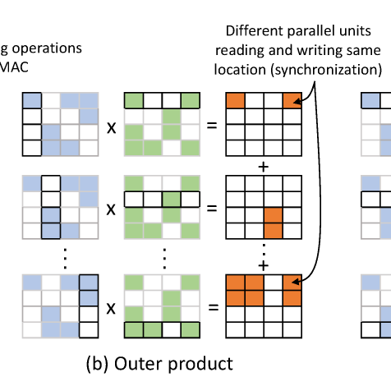
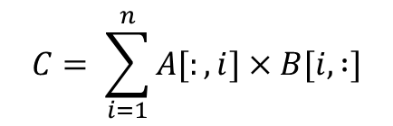
Traditional Solutions
2. Outer Product Method
Advantages:
Improvement in index matching.
Disadvantages:
Inconsistent formatting.
High on-chip memory requirements.
Synchronization is required.
$$C= \sum_{i=1}^{n}{A[:, i]}×B[i, :]$$
N. Srivastava, H. Jin, J. Liu, D. Albonesi, and Z. Zhang, "MatRaptor: A Sparse-Sparse Matrix Multiplication Accelerator Based on Row-Wise Product." Fig. 1.

Slide 5
Challenges with Sparse-Sparse MM Acceleration
Challenges:
Choice Of Algorithm
Inner & outer product not efficient
Memory Bandwidth
Low data reuse
Sparse Output Matrix
Position of non-zeros are unknown
Needs to be produced in parallel
Solution:
MatRaptor: An efficient hardware accelerator for sparse-sparse MM
Key Idea: Co-design algorithm and sparse format.

Slide 6
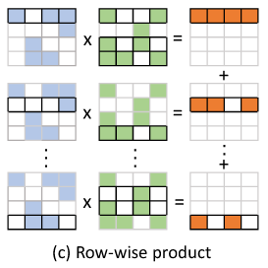

Proposed Solution
Row-wise Product Method
Advantages:
Consistent formatting: Row-major format for matrix A, B and C.
Improved index matching
No synchronization
Medium/low on-chip memory requirements
$$C[i, :]= \sum_{k=1}^{n}{A\left[i,k\right]}×B[k, :]$$
N. Srivastava, H. Jin, J. Liu, D. Albonesi, and Z. Zhang, "MatRaptor: A Sparse-Sparse Matrix Multiplication Accelerator Based on Row-Wise Product." Fig. 1.

Slide 7
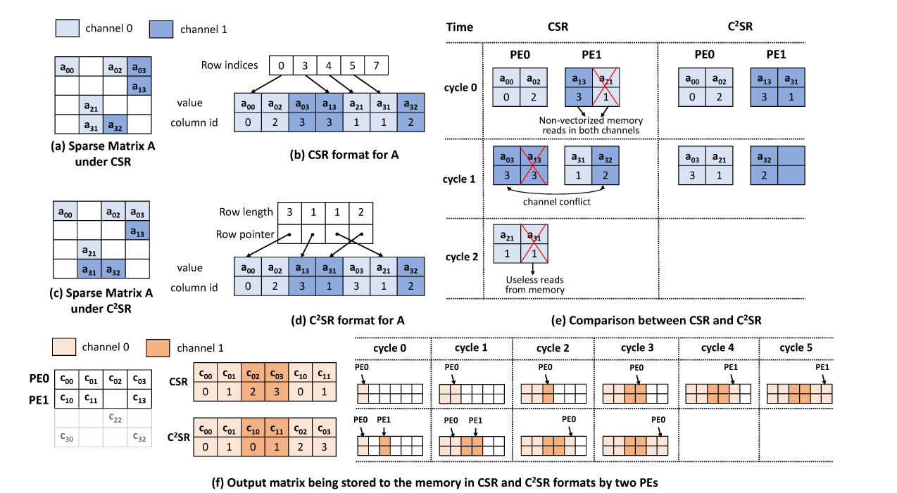

Proposed Solution - $C^{2}SR$ Format
N. Srivastava, H. Jin, J. Liu, D. Albonesi, and Z. Zhang, "MatRaptor: A Sparse-Sparse Matrix Multiplication Accelerator Based on Row-Wise Product." Fig. 3. Comparison of sparse storage formats.

Slide 8
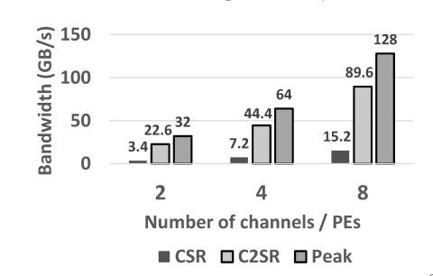
N. Srivastava, H. Jin, J. Liu, D. Albonesi, and Z. Zhang, "MatRaptor: A Sparse-Sparse Matrix Multiplication Accelerator Based on Row-Wise Product." Fig. 6. Achieved memory bandwidth with CSR and C2SR.

Slide 9
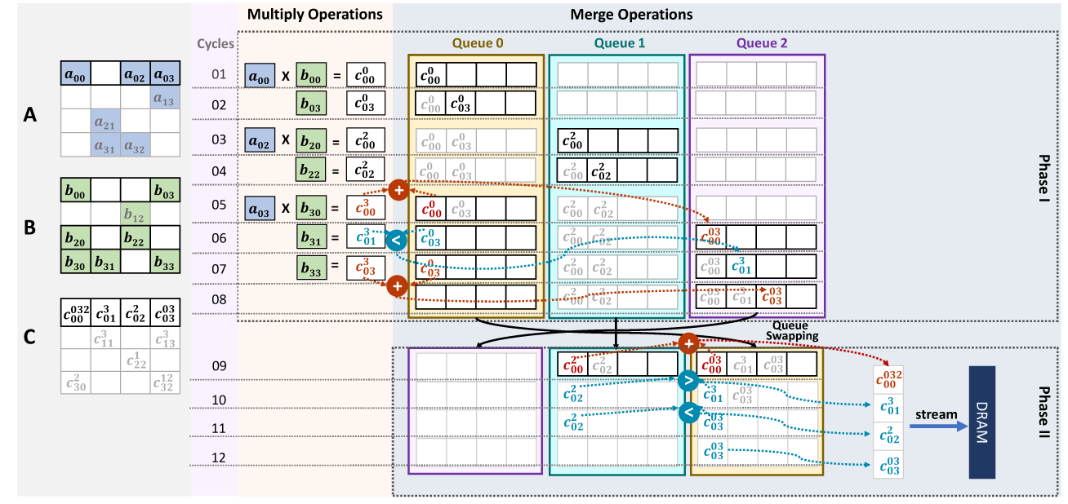
Original Workflow of MatRaptor
N. Srivastava, H. Jin, J. Liu, D. Albonesi, and Z. Zhang, "MatRaptor: A Sparse-Sparse Matrix Multiplication Accelerator Based on Row-Wise Product." Fig. 4. Illustration of Multiply and Merge Operations.

Slide 10
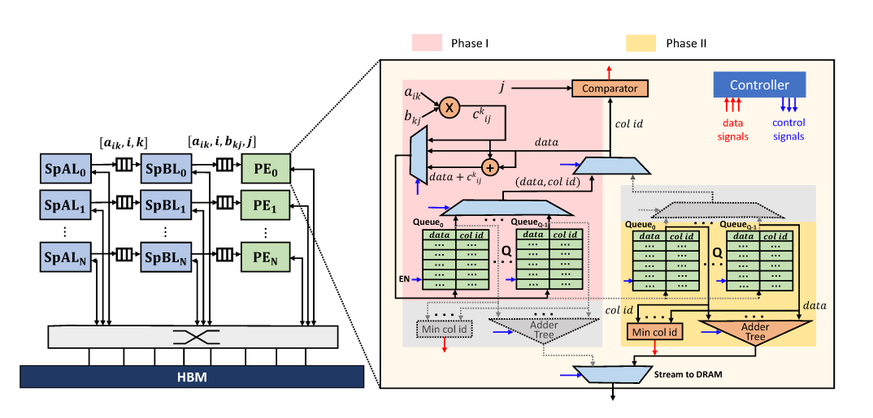

Original Architecture of MatRaptor
N. Srivastava, H. Jin, J. Liu, D. Albonesi, and Z. Zhang, "MatRaptor: A Sparse-Sparse Matrix Multiplication Accelerator Based on Row-Wise Product." Fig. 5. MatRaptor Architecture.

Slide 11
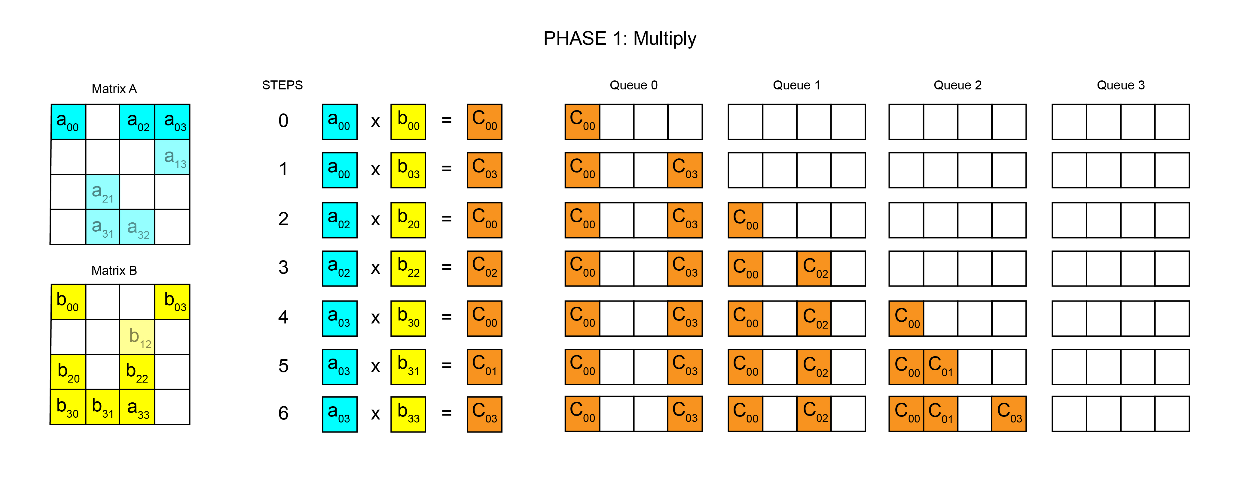
Modified Workflow of MatRaptor

Slide 12
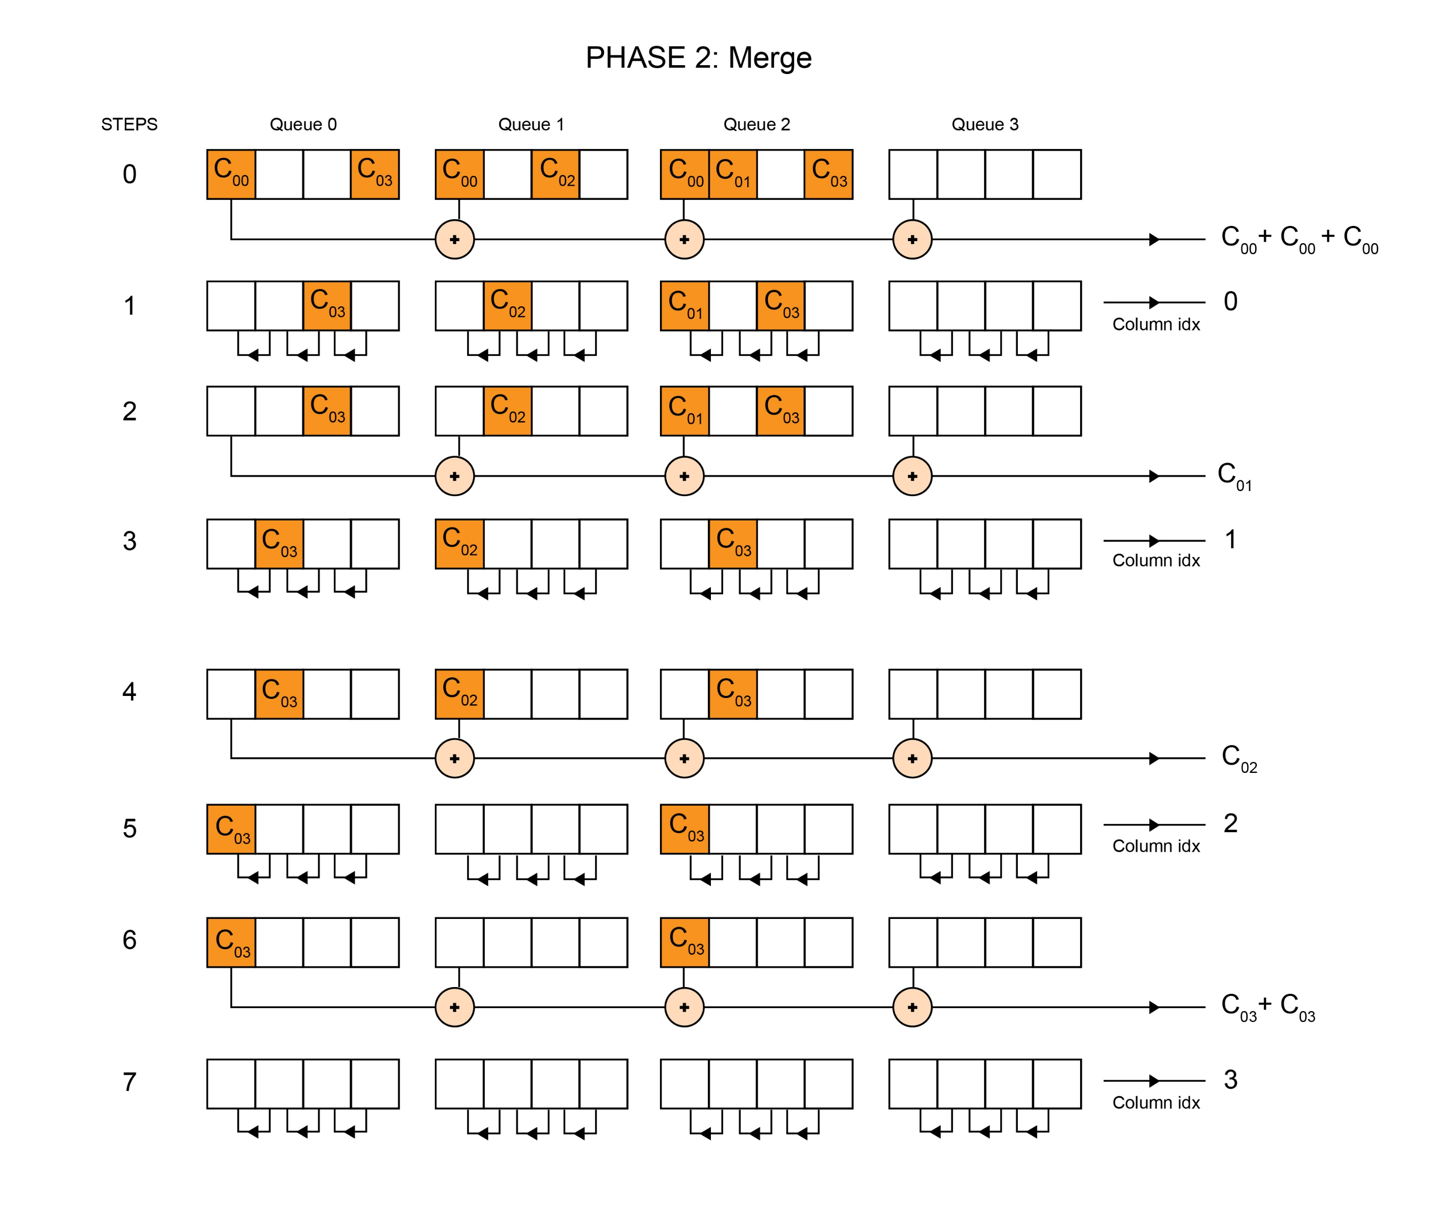

Slide 13
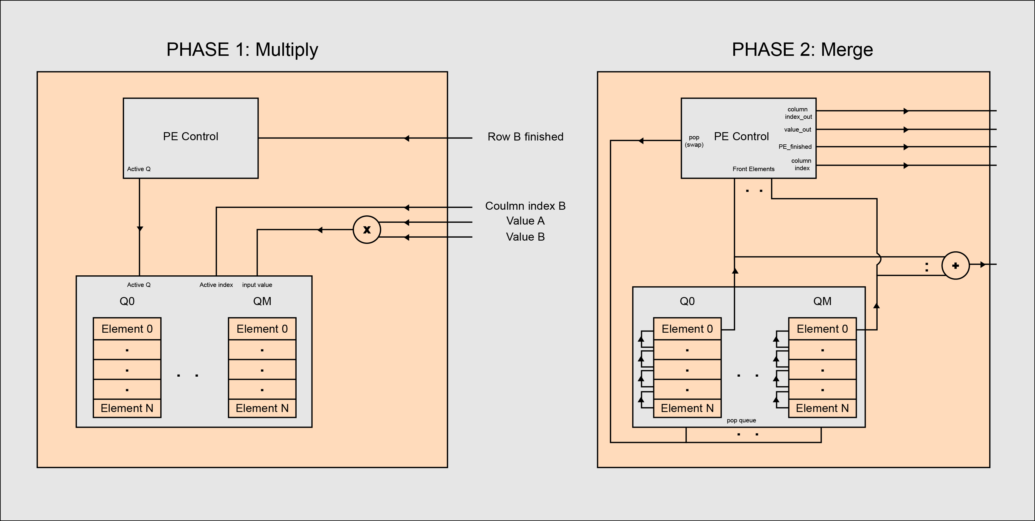
Modified Architecture of MatRaptor PE

Slide 14
Finite State Diagram of Each Module

Slide 15
Sparse Matrix A Loader
If(!control start)
IDLE
Read number of elements
Read Row Pointer
Reset
If(control start)
Row address
If(B_finished && elements_to_read == 0) Row A finished
Wait for loader B
Read index
Read Value
Fetch an Element
Element A out
If(!Row B finished)
If(B_finished && elements_to_read > 0)

Slide 16
Sparse Matrix B Loader
If(!Element A out)
IDLE
Read number of elements
Read Row Pointer
Reset
If(Element A out)
Base address of matrix B
+ element column index
from A loader
If(B_finished && elements_to_read == 0)
Row B finished
Wait for PE
Read index
Read Value
Fetch an Element
Element B out
If(!PE_Ready)
If(PE_Ready && elements_to_read > 0)

Slide 17
Processing Element (PE)
Multiply Phase
If(Element B out)
If(!Loader B ready)
IDLE
Multiply
Reset
If(Loader B ready)
Wait for B
If(Row B finished)
Active queue ++
And stay in state
If(Row A finished)
If(all popped)
Means finished a row in A
Merge Phase
Increment
Counters
POP front of Queues
PE element
out
Merge front of
queues
If(!all popped)

Slide 18
Control Unit
If(!start)
IDLE
Reset
If(start)
Multiply Phase
Base address of matrix A
+ Base address of matrix C
+ Number of rows of A
Merge Phase
Wait for B
If(Row B finished)
Active queue ++
And stay in state
DISTRIBUTE
Rows over
PEs
If(All rows distributed)
Start A Loaders
If(!All rows distributed)
LOOP
If any PE finished give next row

Slide 19
Test Bench Development
Representation of Sparse Matrices A and B in Memory (C²SR Format)
Matrix A:
Row Non-Zero Elements
(Value, Column Index)
---- ---------------------------------------
0 (1, 0), (2, 1)
1 (3, 0)
2 (4, 0)
3 None
Matrix B:
Row Non-Zero Elements
(Value, Column Index)
---- ---------------------------------------
0 (5, 0)
1 (6, 1), (7, 2)
2 (8, 0)
3 (9, 0)
Multiply Phase
Matrix A
Matrix B
1 | 2 | 0 | 0
3 | 0 | 0 | 0
4 | 0 | 0 | 0
0 | 0 | 0 | 0
5 | 0 | 0 | 0
0 | 6 | 7 | 0
8 | 0 | 0 | 0
9 | 0 | 0 | 0
Wait for B
If(Row B finished)
Active queue ++
And stay in state

Slide 20
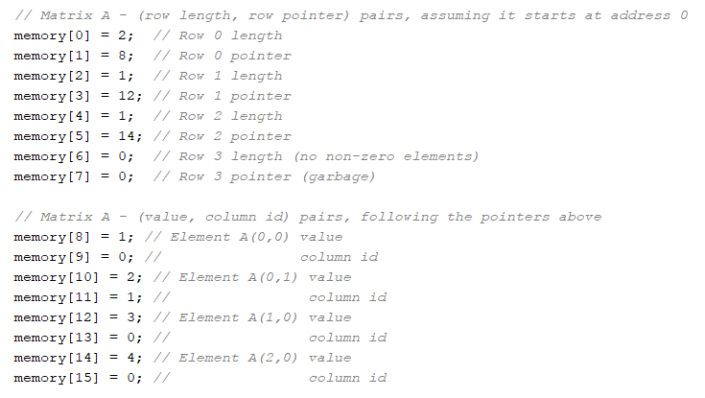
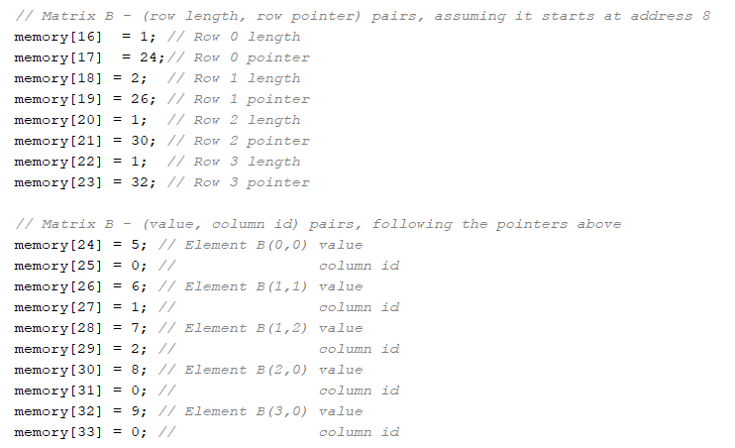
Test Bench Development
Representation of Sparse Matrices A and B in Memory (C²SR Format)
Multiply Phase
Matrix A
Matrix B

Slide 21
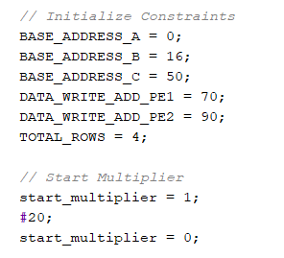
Test Bench Development
Row Distribution Method: Round Robin
Input matrix (A) base pointer: 0x0
Input matrix (b) base pointer: 0x16
Output matrix (C) base pointer: 0x50
Number of PEs: 2
PE1 Write Address: 0x70 (Assuming these addresses are in independent memory channels).
PE2: Write Address: 0x90.

Slide 22
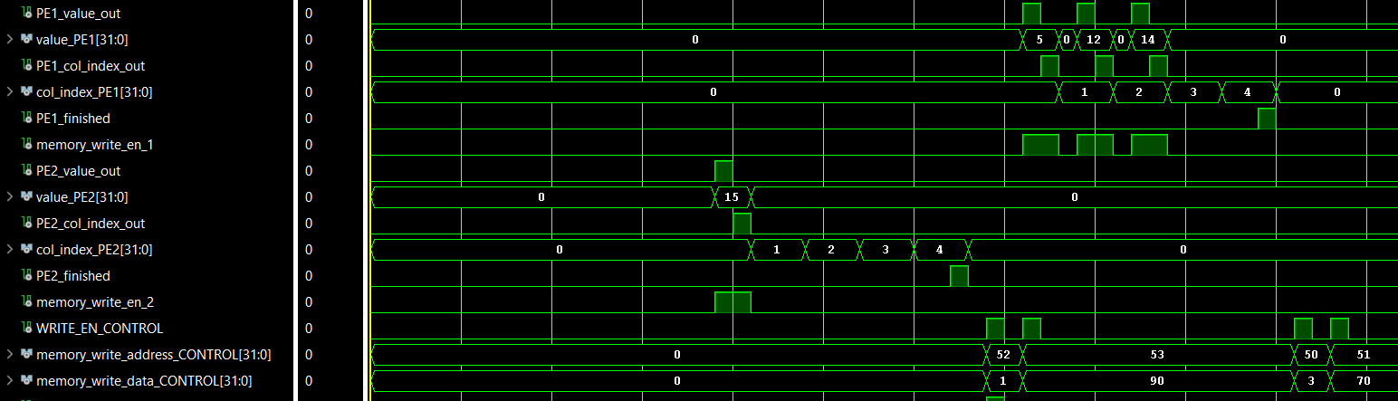
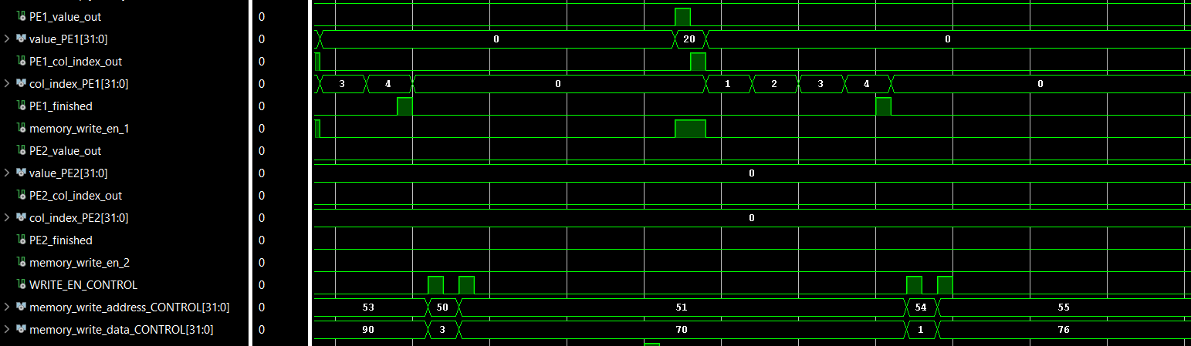
Test Bench Results (PE1)
Only one aspect is being presented here which is the output elements and the corresponding column index
Continuation:

Slide 23
Test Bench Results (PE2)
Only one aspect is being presented here which is the output elements and the corresponding column index
Continuation:

Slide 24
Test Bench Results
It took exactly 1700 ns (1.7 us) to complete the multiplication of the 2 matrices A and B
PE2 finished his assigned rows at 660 ns, wile PE1 finished at 1620 ns
There are many improvements that can be made in the design to make it even faster, yet more complicated.

